Slide 1
8. Unsupervised Learning (I)
IT 348/448

Slide 2
Topics
Clustering
Partitioning Approach
Density-based Approach
Hierarchical Approach

Slide 3
Readings
Chapter 9
Hands-On Machine Learning with Scikit-Learn, Keras, and TensorFlow (3rd Edition) by Aurélien Géron (Author)
https://learning.oreilly.com/library/view/hands-on-machine-learning/9781098125967/
Clustering_Analysis.pdf
/Readings/ in Canvas

Slide 4
What is Cluster Analysis?
Finding groups of objects such that the objects in a group will be similar (or related) to one another and different from (or unrelated to) the objects in other groups
Inter-cluster distances are maximized
Intra-cluster distances are minimized

Slide 5
Why cluster?
Labeling is expensive
Gain insight into the structure of the data
Find prototypes in the data

Slide 6
What is Cluster Analysis?
Cluster: a collection of data objects
Similar to one another within the same cluster
Dissimilar to the objects in other clusters
Cluster analysis
Grouping a set of data objects into clusters
Clustering is unsupervised classification:
No predefined classes
Typical applications
As a stand-alone tool to get insight into data distribution
As a preprocessing step for other algorithms

Slide 7
General Applications of Clustering
Pattern Recognition
Spatial Data Analysis
create thematic maps in GIS by clustering feature spaces
detect spatial clusters and explain them in spatial data mining
Image Processing
WWW
Document classification
Cluster Weblog data to discover groups of similar access patterns

Slide 8
Examples of Clustering Applications
Marketing: Help marketers discover distinct groups in their customer bases, and then use this knowledge to develop targeted marketing programs
Land use: Identification of areas of similar land use in an earth observation database
Insurance: Identifying groups of motor insurance policy holders with a high average claim cost
City-planning: Identifying groups of houses according to their house type, value, and geographical location
Earth-quake studies: Observed earth quake epicenters should be clustered along continent faults

Slide 9
Notion of a Cluster can be Ambiguous
How many clusters?
Six Clusters
Two Clusters
Four Clusters

Slide 10
What Is Good Clustering?
A good clustering method will produce high quality clusters with
high intra-class similarity
low inter-class similarity
The quality of a clustering result depends on both the similarity measure used by the method and its implementation.
The quality of a clustering method is also measured by its ability to discover some or all of the hidden patterns.

Slide 11
Measure the Quality of Clustering
Dissimilarity/Similarity metric: Similarity is expressed in terms of a distance function:
d(i, j)
Quality of Clustering
There is a separate “quality” function that measures the “goodness” of a cluster.
It is hard to define “similar enough” or “good enough”
the answer is typically highly subjective.

Slide 12
Major Clustering Approaches
Partitioning approach:
Construct various partitions and then evaluate them by some criterion, e.g., minimizing the sum of square errors
Typical methods: k-means, k-medoids, CLARANS
Density-based approach:
Based on connectivity and density functions
Typical methods: DBSACN, OPTICS, DenClue
Hierarchical approach:
Create a hierarchical decomposition of the set of data (or objects) using some criterion
Typical methods: Diana, Agnes, BIRCH, CAMELEON

Slide 13
Partitioning Approach

Slide 14
Partitioning Algorithms: Basic Concept
Construct a partition of a database D of n objects into a set of k clusters
Given a k, find a partition of k clusters that optimizes the chosen partitioning criterion
Global optimal: exhaustively enumerate all partitions
Heuristic methods: k-means and k-medoids algorithms
k-means (MacQueen’67): Each cluster is represented by the center of the cluster
k-medoids or PAM (Partition around medoids) (Kaufman & Rousseeuw’87): Each cluster is represented by one of the objects in the cluster

Slide 15
The sum of squared error
Partitioning method:
Partitioning a dataset D of n objects into a set of k clusters, such that the sum of squared distances is minimized:
E is the sum of the squared error for all objects in the dataset;
p is the point in space representing a given object;
c_{i} is the centroid or medoid of cluster C_{i}

Slide 16
The K-Means Clustering Method
Given k, the k-means algorithm is implemented in four steps:
Partition objects into k nonempty subsets
Compute seed points as the centroids of the clusters of the current partition (the centroid is the center, i.e., mean point, of the cluster)
Assign each object to the cluster with the nearest seed point
Go back to Step 2, stop when no more new assignment

Slide 17
The K-Means Clustering Method
10
10
9
9
8
8
7
7
6
6
5
5
4
Assign each objects to most similar center
Update the cluster means
4
3
3
2
2
1
1
0
0
0
1
2
3
4
5
6
7
8
9
10
0
1
2
3
4
5
6
7
8
9
10
reassign
reassign
K=2
Arbitrarily choose K object as initial cluster center
Update the cluster means

Slide 18
Comments on the K-Means Method
Strength: Relatively efficient: O(tkn), where n is # objects, k is # clusters, and t is # iterations. Normally, k, t << n.
Comment: Often terminates at a local optimum. The global optimum may be found using techniques such as: deterministic annealing and genetic algorithms.
Weakness
Applicable only when mean is defined.
Need to specify k, the number of clusters, in advance
Unable to handle noisy data and outliers

Slide 19
What is the problem of k-Means Method?
The k-means algorithm is sensitive to outliers!
Since an object with an extremely large value may substantially distort the data distribution.
K-Medoids: Instead of taking the mean value of the object in a cluster as a reference point, medoids can be used, which is the most centrally located object in a cluster.
10
10
9
9
8
8
7
7
6
6
5
5
4
4
3
3
2
2
1
1
0
0
1
2
3
4
5
6
7
8
9
10
0
0
1
2
3
4
5
6
7
8
9
10

Slide 20
The K-Medoids Clustering Method
Find representative objects, called medoids, in clusters
PAM (Partitioning Around Medoids)
Starts from an initial set of medoids and iteratively replaces one of the medoids with one of the non-medoids if it improves the total distance of the resulting clustering
PAM works effectively for small data sets but does not scale well for large data sets

Slide 21
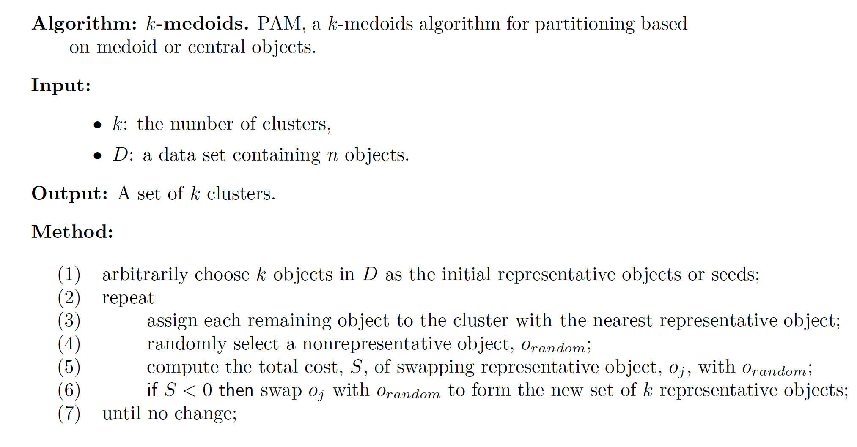
PAM (Partitioning Around Medoids)

Slide 22
Typical k-medoids algorithm (PAM)
Total Cost = 20
10
9
8
Arbitrary choose k object as initial medoids
Assign each remaining object to nearest medoids
7
6
5
4
3
2
1
0
0
1
2
3
4
5
6
7
8
9
10
K=2
Randomly select a nonmedoid object, O_{ramdom}
Total Cost = 26
Do loop
Until no change
10
10
9
9
8
8
Swapping O and O_{ramdom}
If quality is improved.
7
7
6
Compute total cost of swapping
6
5
5
4
4
3
3
2
2
1
1
0
0
1
2
3
4
5
6
7
8
9
10
0
0
1
2
3
4
5
6
7
8
9
10

Slide 23
What is the problem with PAM?
PAM is more robust than k-means in the presence of noise and outliers because a medoid is less influenced by outliers or other extreme values than a mean
PAM works efficiently for small data sets but does not scale well for large data sets.
O(k(n-k)² ) for each iteration
where n is # of data, k is # of clusters

